Slide 1
COMPANY HUB
User Guide for Company Account Administrators

Slide 2
TABLE OF CONTENTS
Glossary
Log into your company account
Homepage of your company hub
Edit my profile
Lead Manager App: The Lead Generation Solution
Manage your company badges
E-shop
Manage company entitlements
Upgrade your package
Your Company dashboard analytics
Your delegates view and actions
Need any assistance?

Slide 3
GLOSSARY
Affiliates : Companies or individuals officially attached to the main stand holder, often for the purpose of marketing and sales.
Dashboard : Interface where you can monitor your leads and your company page statistics
Emperia on-site lead capture : Emperia app that allows exhibitors to scan visitors' badges at the market and find their contacts in the online dashboard.
Primary administrator : The main contact in your company to prepare the market who has access to the company page, receive Emperia lead notifications, register exhibitor delegates, invite affiliates and add other secondary administrators. Once added, secondary administrators can have the same rights as the primary one (unlimited additional secondary admins).

Slide 4
HOW TO LOG IN TO YOUR COMPANY SPACE ?
Once your participation is confirmed, you will receive an email from RX Global : no-reply@rxglobal.com
If you exceed this deadline or if you have not received the email (remember to check your spam), contact our customer service. Help Desk
Click on the link received by email and personalize your password

Slide 5
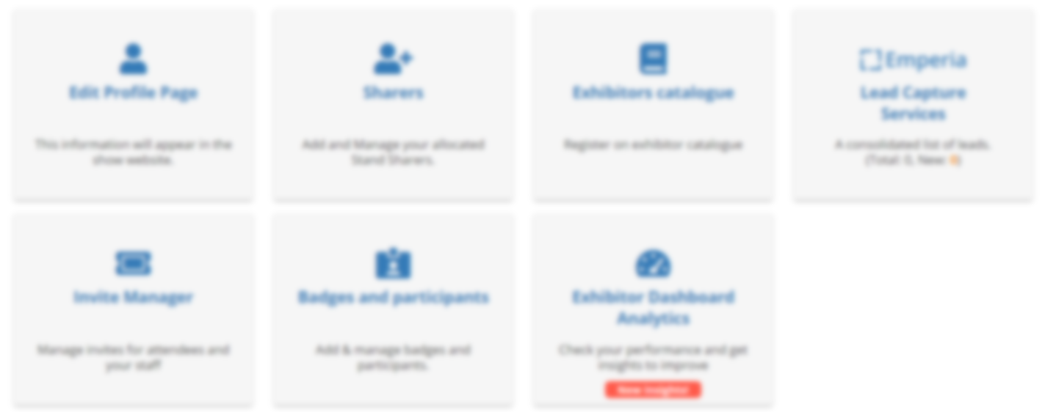
HOMEPAGE OF YOUR COMPANY HUB
Here you will find the name of your company
Here you will find the name of your package type
Here are the details of each section of your Company Hub

Slide 6
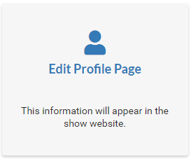
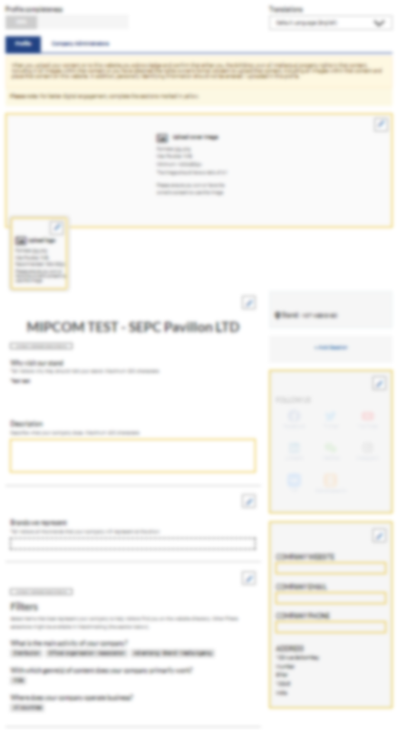
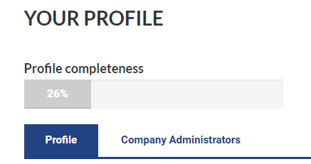
EDIT MY PROFILE
The profile editing section is made up of two parts, one dedicated to editing your company profile, the other to managing/adding other administrators from your company.
Complete all the elements that will be used for:
your listing on the fair's website search engine
your recommendation to visitors who pre-register
Here you will be able to navigate between both parts
Profile
Company Administrators
Access the profile section to modify your company's information
Please complete your company profile with as many details as possible !
Logo, description, cover image... Boost your business opportunities!

Slide 7
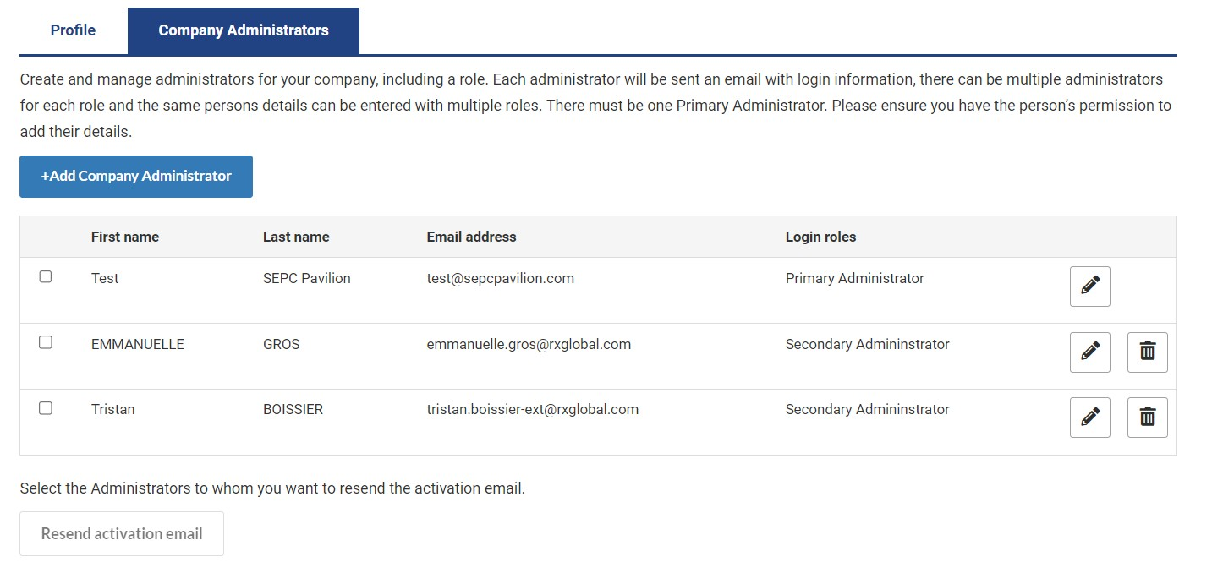
EDIT MY PROFILE - COMPANY ADMINISTRATOR TAB
Exhibitor administrators are individuals from your company who require access to the exhibitor space. Secondary administrators will have the same access as the primary administrator.
Please add any of your colleagues who should have access to the company page full set up.
They will receive an activation email.
Resend the activation email to the company page (in case your colleague did not receive it)
Update your company admins list at anytime

Slide 8
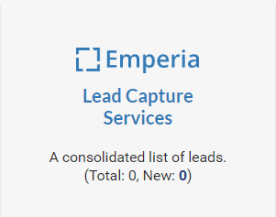
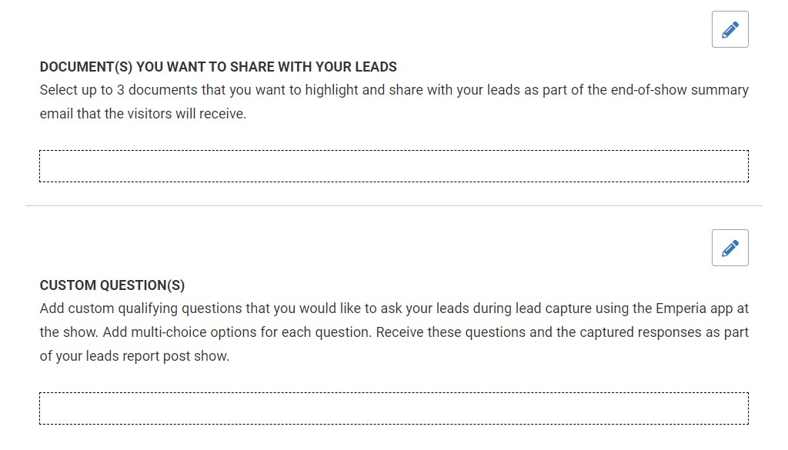
Lead Manager App (ex-Emperia) : The Lead Generation Solution
Mobile App to scan visitors' badge
Emperia is a mobile app to scan visitors' badges at the exhibition. Collect contacts and find them in your online report available on your exhibitor dashboard.
Customize your account by indicating your company access code
XXXXX
Download the Emperia Mobile app from the App Store or Google Play
Upload up to 3 documents about your company sent to the visitors you scan at the market
Add personalized questions. These will be available on your Emperia application, so you can easily answer the questions you ask visitors on a recurring basis.

Slide 9
Lead Manager App (ex-Emperia) : The Lead Generation Solution Download your leads
Every day during the fair or at its conclusion, you have access to visitors who have been scanned by all your collaborators.
At the end of the fair, individuals who have been scanned will receive the documents you have uploaded in the Emperia menu of your exhibitor space, as well as your contact details.
Download the full list of all your online leads and scanned contacts in 1 report available in .csv or .xlsx format

Slide 10
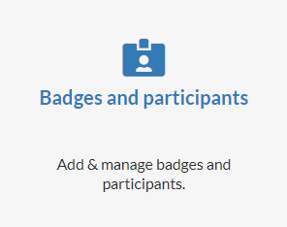
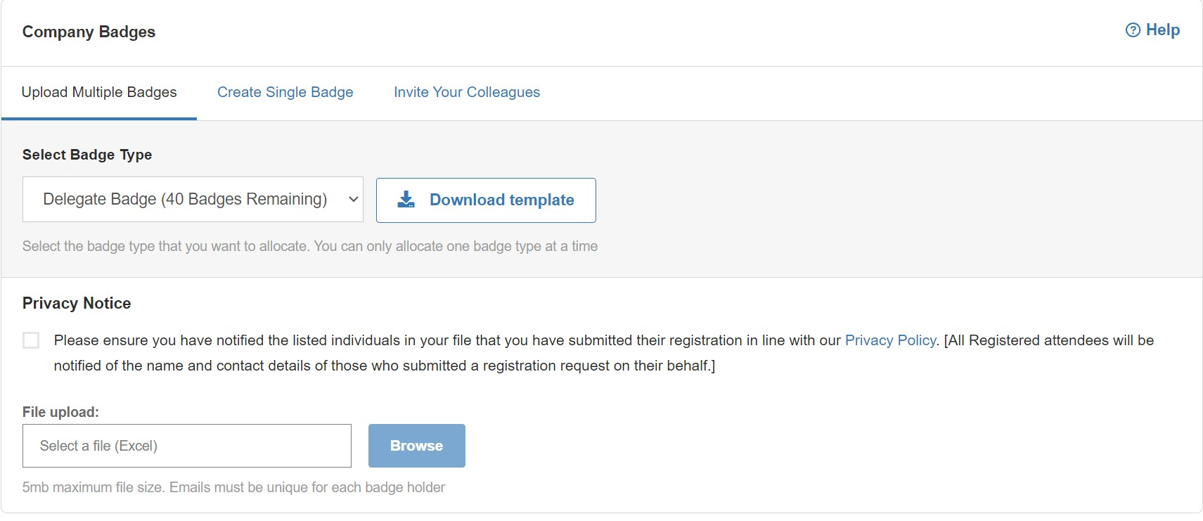
MANAGE YOUR COMPANY BADGES
Managing delegates registrations in your stand quota
Exhibitor badges provide access to the fair before the opening hours for visitors and during the setup and dismantling days.
The Allocate Badges section allows you to add one or more badges for your colleagues.
Here you will be able to navigate between both parts :
Allocate badges
Your company badges
Click here if you want to create a single badge
Use this template to upload multiple delegates at the same time

Slide 11
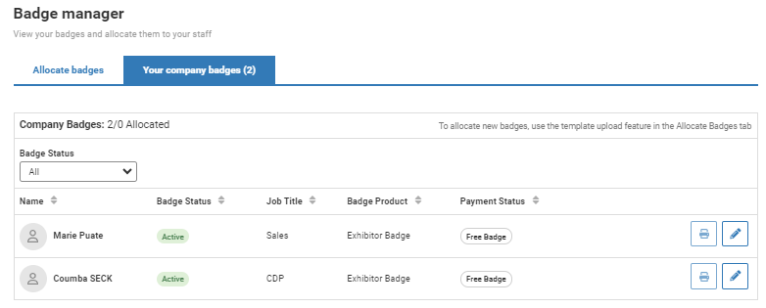
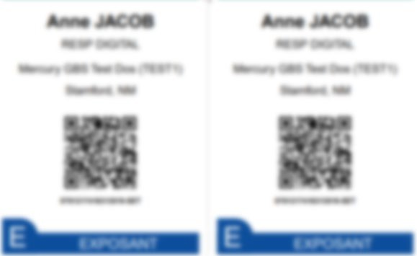
MANAGE YOUR COMPANY BADGES
Managing delegates registrations in your stand quota
Badges are available for download and printing 15 days before the show. However, you must have properly completed your profile in its entirety in advance in order to access your badge.
Get and print your badges using this button.
Here you can find the exhibitor badges you have uploaded
Here you can find the payment status of the badge
You can modify them (with the exception of the email address). If you modify the badge, you will need to re-print as the previous one will no longer be valid.

Slide 12
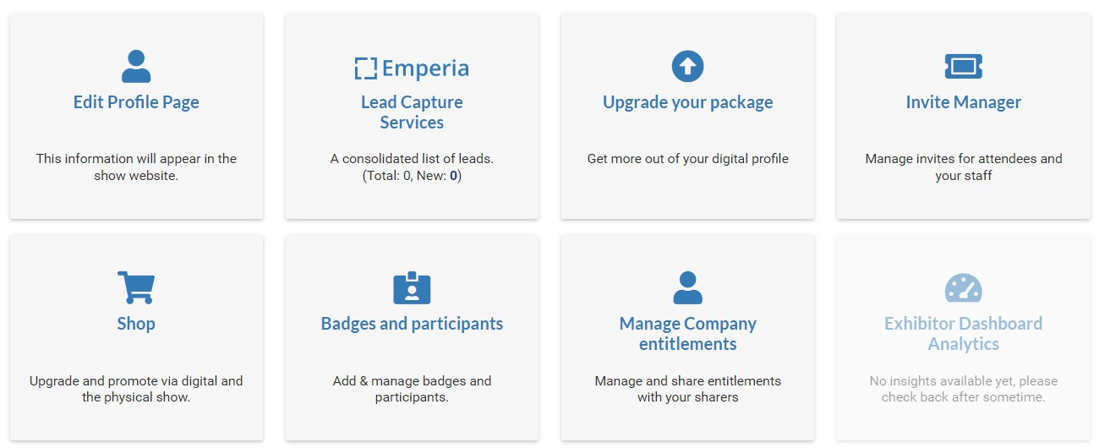
MANAGE YOUR COMPANY BADGES
Purchase additional delegate badges from your quota stand

Slide 13
MANAGE YOUR COMPANY BADGES
You can modify them
(with the exception of the email address)If you modify the badge, you will need to re-print as the previous one will no longer be valid.

Slide 14
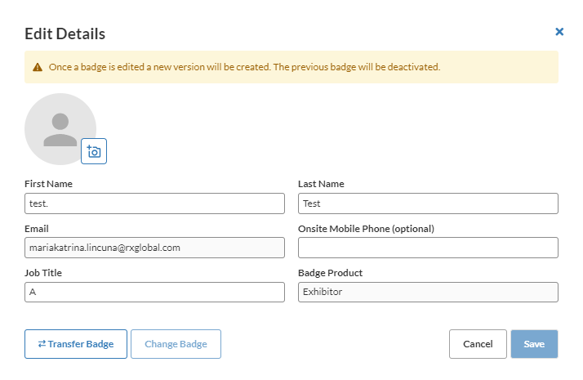
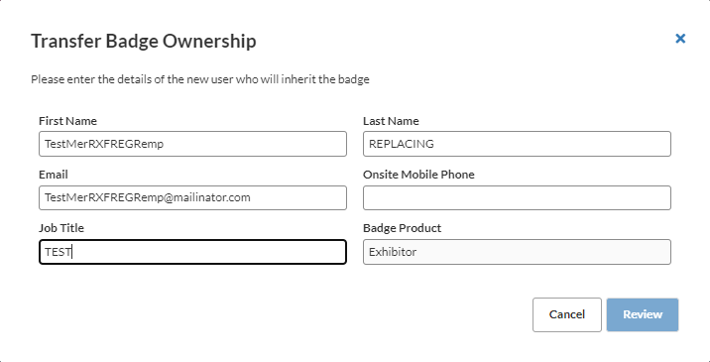
MANAGE YOUR COMPANY BADGES Transfer a badge
You can transfer a badge from one participant to another within your company. Note that the first registration will be cancelled, and the participant will receive a cancellation notification.
Click on “Modify”
Click on “Transfer Badge”
Click on “”Review” and Validate”

Slide 15
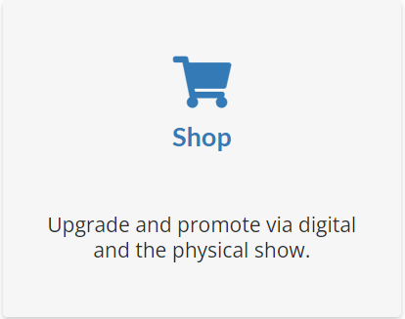
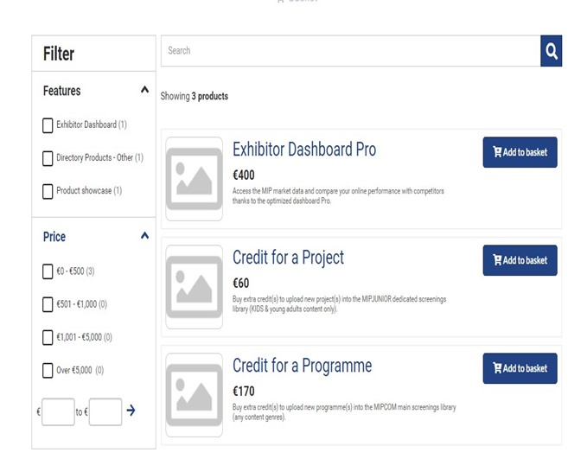
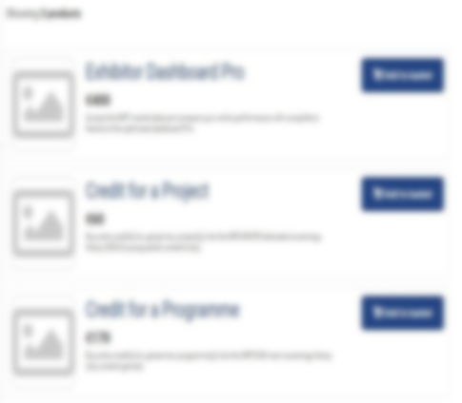
E-SHOP SECTION Purchase digital services
Purchase additional services by adding them to your basket and proceeding to payment shop. Get 20% of programmes by purchasing 3 or more (discount at check out)
You can use filters by product type and price in order to choose the products that best meet your needs

Slide 16
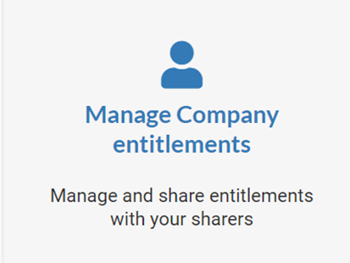
MANAGE COMPANY ENTITLEMENTS
Please find below your available purchased credits and entitlements for your additional services.

Slide 17
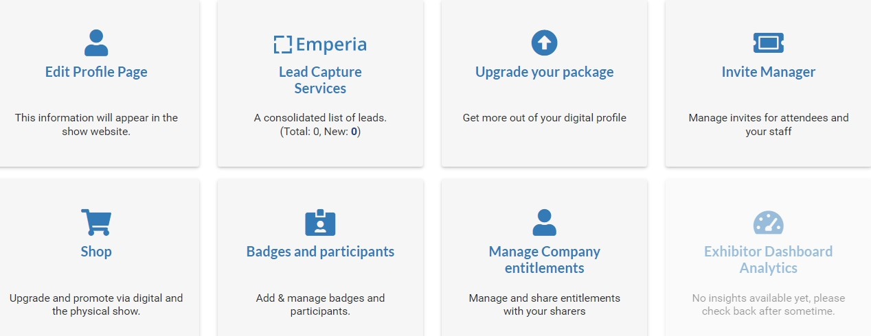
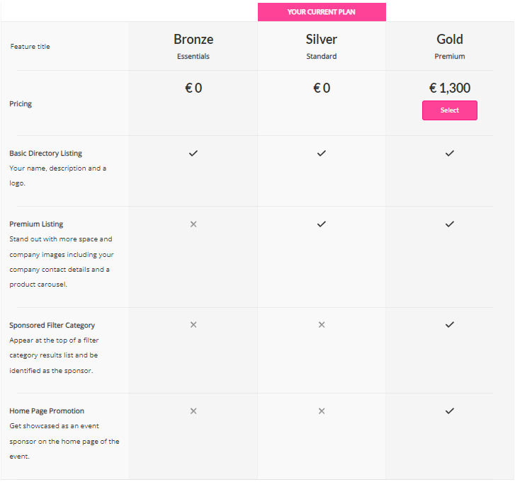
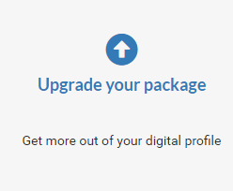
UPGRADE YOUR DIGITAL PACKAGE: INCREASE YOUR VISIBILITY
YOUR CURRENT PLAN
Select
Get more visibility by upgrading your digital package. Get your company page promoted on top of everyone else

Slide 18
UPGRADE YOUR PACKAGE: INCREASE YOUR VISIBILITY
The mention "your current plan" indicates the offer already included in your online services package
YOUR CURRENT PLAN
Select
Choose the package of your choice by adding it to your basket before proceeding to payment
On the left, you will find all the explanations about the various options available

Slide 19
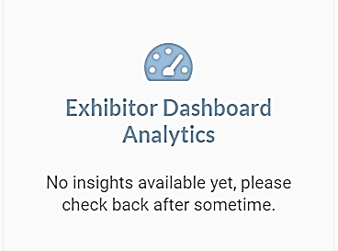
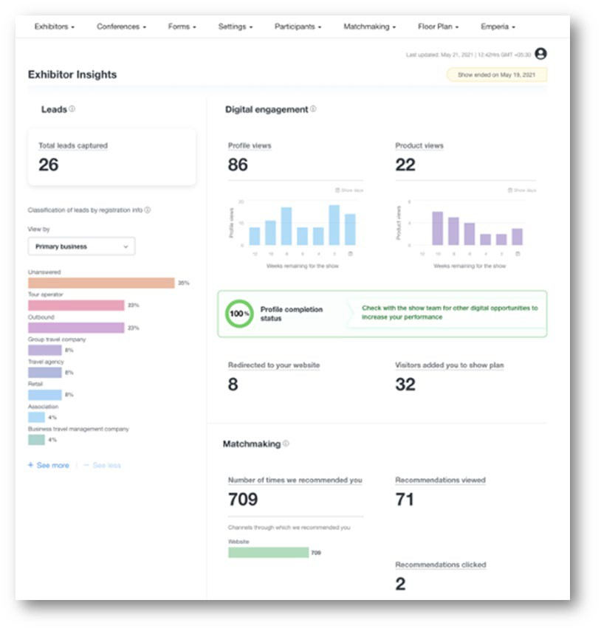
COMPANY DASHBOARD ANALYTICS
The Exhibitor Dashboard allows you to access a wealth of data regarding your performance at the exhibition.
This dashboard synthesizes your leads generated during the show (with Emperia app). A large amount of data is available to help you understand the typology of your leads, your strengths, and areas for improvement for your next exhibition.
Its pro version also allows you to compare yourself with your competitors.
This page only becomes accessible 90 days before the show.

Slide 20
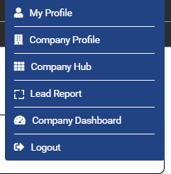
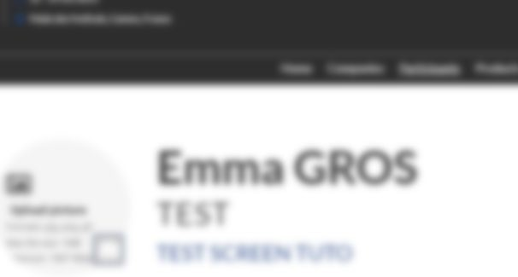
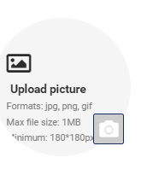
YOUR DELEGATES VIEW AND ACTIONS
What does your delegates access on the company hub ?
As soon as they are registered the delegate will receive an automatic e-mail to connect to their profile
Delegate will connect to their profile and will have access to upload their picture to receive the badge (available 2 weeks before the event)
Delegate will connect to their profile and will have access to upload their picture to receive the badge (available 2 weeks before the event)
This section, located at the top right of the screen, allows them to navigate between their company profile and their personal profile.
This section, located at the top right of the screen, allows them to navigate between their company profile and their personal profile.

Slide 21
NEED ANY ASSISTANCE?
Contact our Customer Helpdesk :
By phone : (+33) 1 47 56 65 00.
Our telephone service is open from Monday to Friday, 9am to 6pm CET.
By form

